Slide 1
Flexible Spending Accounts
Spend every day wisely

Slide 2
Your Flexible Spending Account (FSA)
Making it easier to manage medical and dependent care costs while you work.
Expense accounts that help you pay qualified medical and dependent care expenses tax-free.
Set aside a portion of pretax payroll.
You could save 10% to 40% on these costs, depending on tax bracket¹.

Slide 3
How your FSA works – getting started
Estimate next year’s eligible medical and dependent care costs, and elect to contribute up to that amount to an FSA.
Employer opens an FSA for you.
Equal portions deposited from your paycheck:
Money for medical FSA is available day one.
Money for dependent care is available when deposited.
Contribute no more than what you think you will use, up to the applicable limit for the year².
A spouse in another plan may also open an FSA:
Medical FSA – each spouse can pledge up to $3,200³ for 2024.
Dependent Care FSA – combined limit is $5,000.

Slide 4
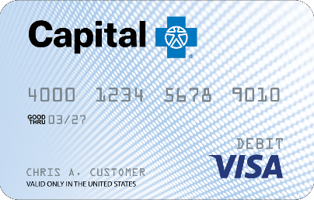
How your FSA works – paying medical expenses
Submit claims for reimbursement – online, fax, or mobile app.
Our convenient Capital Blue Cross VISA® debit card⁴ can also be used for medical expenses.

Slide 5
Meet the Garcia family
Two-parent family of four
Maria’s annual salary | $46,000
Carlos’ annual salary | $42,000
Taxable income | $88,000
Medical FSA contribution | $1,200
Dependent care FSA contribution | $5,000
Taxable income with FSAs | $81,800
Estimated tax rate⁵ | 25%

Slide 6
The Garcia family’s savings
 | Without an FSA | With an FSA
Medical FSA contribution | $0 | $1,200
Dependent care FSA contribution | $0 | $5,000
The family’s estimated taxes⁵ | $22,000 | $20,450
Healthcare expenses | $1,200 | $1,200
Dependent care expenses | $5,000 | $5,000
The family’s tax savings | $0 | $1,550
Net disposable income | $59,800 | $61,350

Slide 7
Qualified medical expenses
Expenses you can pay for:
Over-the-counter supplies, medications, and some feminine hygiene products.
Personal protective equipment such as masks, hand sanitizer, and sanitizing wipes.
Medical expenses that your health plan doesn’t cover:
Your deductible.
Copays and coinsurance.
Health expenses not included in your health plan:
Dental and vision care.
You can't use your FSA to pay for:
Costs not considered IRS-qualified expenses.
Visit the learning center at CapBlueCross.com/funds.
Health insurance premiums.

Slide 8
Qualified dependent care expenses⁶
You can use your FSA to pay for:
Licensed daycare facilities.
Licensed before and after-school programs.
In-home care services.
Elder care.
Day camp expenses.
You can't use your FSA to pay for:
Kindergarten or school tuition.
School lunches and food items.
School activity fees.
Overnight camp.

Slide 9
After you’re enrolled
Receive your debit card by mail.
Use your debit card to pay healthcare providers.
Visit CapBlueCross.com/funds often to:
View account activity.
Submit claims for dependent care reimbursement.
Check balances.
Get forms.
Upload receipts.
Request additional debit cards.

Slide 10
Let’s get started
Our expert service team is ready to help.
877.293.7041
Monday-Friday, 8:00 AM-9:00 PM ET Saturday-Sunday, 9:00 AM-5:00 PM ET
CapBlueCross.com/funds
PSI-31 (11/30/23)

