Slide 1
Health Savings Accounts
Spend every day wisely

Slide 2
Your Health Savings Account (HSA)
Account you own that works with your HSA-qualified health plan.
Allows you to set aside a portion of pretax payroll.
No taxes on money you put in or take out to pay for qualified medical expenses.
Interest earned is tax-free.
No “use it or lose it;” unused money rolls to next year.
Account stays with you, even if you change jobs or health plans, or retire.

Slide 3
Member advantages of an HSA
Called the triple tax advantage, an HSA allows its owner to see significant tax benefits beyond what other types of healthcare spending accounts allow.
Contribute – tax-free.
Spend – tax-free.
Earn interest – tax-free.

Slide 4
Employer advantages of an HSA
Premium costs for QHDHPs are lower than other types of health plans.
Contributed HSA funds are tax deductible.
Educates employees on the true cost of healthcare services.

Slide 5
Make sure you are eligible
Enroll in an HSA-qualified health plan.
Ensure you:
Are not claimed as a dependent on someone else’s tax return (i.e., children).
Have no other health plan coverage (including spouse’s medical FSA¹).
Are not enrolled in Medicare.

Slide 6
Contribute and manage your funds
Set aside a portion of your payroll pretax:
2023 maximum contribution: $3,850 for self only, $7,750 for family.
2024 maximum contribution: $4,150 for self only, $8,300 for family.
Convenient Capital Blue Cross VISA® debit card² to pay for qualified healthcare expenses.
Make direct payments to providers or reimburse yourself for out-of-pocket costs.

Slide 7
Meet Molly
Single professional, no children.
Annual salary | $48,000
HSA contribution | $3,000
Taxable income | $45,000
Estimated tax rate¹ | 25%

Slide 8
Molly’s savings
 | Without an HSA | With an HSA
Estimated taxes¹ | $12,000 | $11,250
Tax savings | $0 | $750
Healthcare expense | $600 | $600
HSA account | $0 | $3,000
HSA balance to roll over | $0 | $2,400
At year’s end, Molly has not only saved $750 in taxes, but has used those savings to cover all of her healthcare expenses AND established an HSA account that is available for future costs.

Slide 9
You can use your HSA to pay for:
You can’t use your HSA to pay for:
Medical expenses that your health plan doesn’t cover:
Your deductible.
Copays and coinsurance.
Prescription drugs.
Dental and vision care expenses not included in your health plan.
Costs not on the list of IRS-qualified expenses.
Visit the learning center at CapBlueCross.com/Funds.
Over-the-counter medicine.
Nonprescription drugs.
Supplements.
Health insurance premiums.

Slide 10
Meet the Martinez family
Single parent and one teen.
Annual salary | $68,000
HSA contribution | $5,000
Taxable income | $63,000
Estimated tax rate¹ | 25%

Slide 11
The Martinez’s savings
 | Without an HSA | With an HSA
Estimated taxes¹ | $17,000 | $15,750
Tax savings | $0 | $1,250
Healthcare expense | $2,450 | $2,450
HSA account | $0 | $5,000
HSA balance to roll over | $0 | $2,550
At year’s end, the Martinez family has not only saved $1,250 in taxes, but has used those savings to cover approximately half of their healthcare expenses. They have also established an HSA account that is available for future expenses.

Slide 12
Meet the Robinson family
Two-parent family with two school-age children.
Combined annual salary | $94,000
HSA pretax contribution (2024 limit) | $8,300
Net taxable income | $85,700
Estimated tax rate¹ | 25%

Slide 13
The Robinson’s savings
 | Without an HSA | With an HSA
Estimated taxes¹ | $23,500 | $21,425
Tax savings | $0 | $2,075
Healthcare expense | $1,850 | $1,850
HSA account | $0 | $8,300
HSA balance to roll over | $0 | $6,450
At year’s end, the Robinson family has not only saved $2,075 in taxes, but they have used those savings to cover all of their healthcare expenses and established an HSA account that is available for future expenses.

Slide 14
Meet Bill and Emily
Empty nesters retiring in five years.
Combined annual salary | $125,000
HSA pretax contribution (2024 limit plus additional $1,000 catch-up contribution) | $9,300
Net taxable income | $115,700
Estimated tax rate¹ | 25%

Slide 15
Bill and Amy’s savings
 | Without an HSA | With an HSA
Estimated taxes¹ | $31,250 | $28,925
Tax savings | $0 | $2,325
Healthcare expense | $1,400 | $1,400
HSA account | $0 | $9,300
HSA balance to roll over | $0 | $7,900²
At year’s end, Bill and Amy have not only saved $2,325 in taxes, but they have used those savings to cover all of their healthcare expenses and established an HSA account that is available for future expenses.

Slide 16
Investment options*
$10,000+
$1,000-10,000+
$1,000+
$1,000 minimum
Basic investment account
Self-directed brokerage account
$0-$1,000
A minimum of $1,000 required in your HSA base balance

Slide 17
More than 30 mutual funds offered
Quarterly investment statements.
Review activity.
Manage asset allocation.
View fund performance.

Slide 18
After you’re enrolled
Receive your Capital Blue Cross VISA debit card by mail.
Use your debit card to pay for qualified healthcare expenses.
Visit CapBlueCross.com/Funds to:
View account activity and check balances.
Get forms and upload receipts.
Request additional debit cards.
View and manage investments over $1,000.

Slide 19
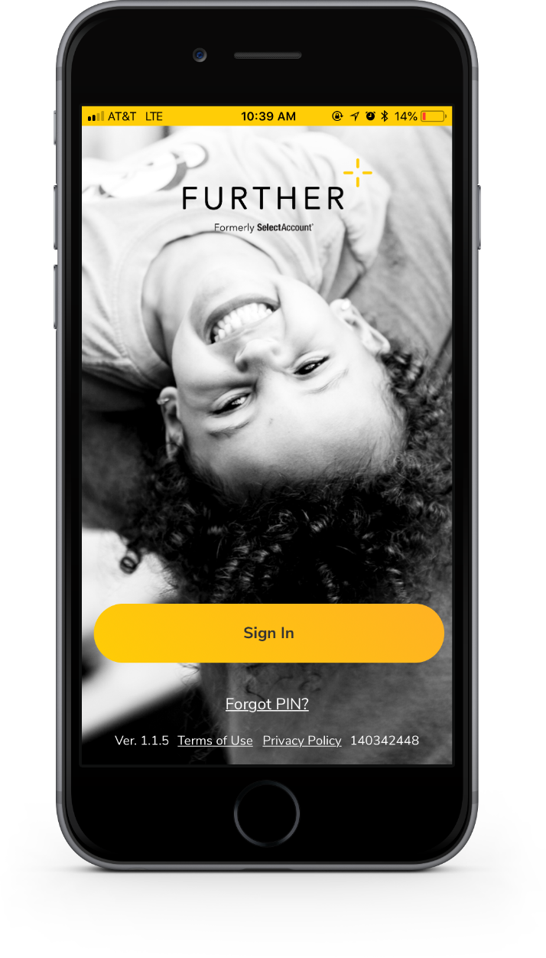
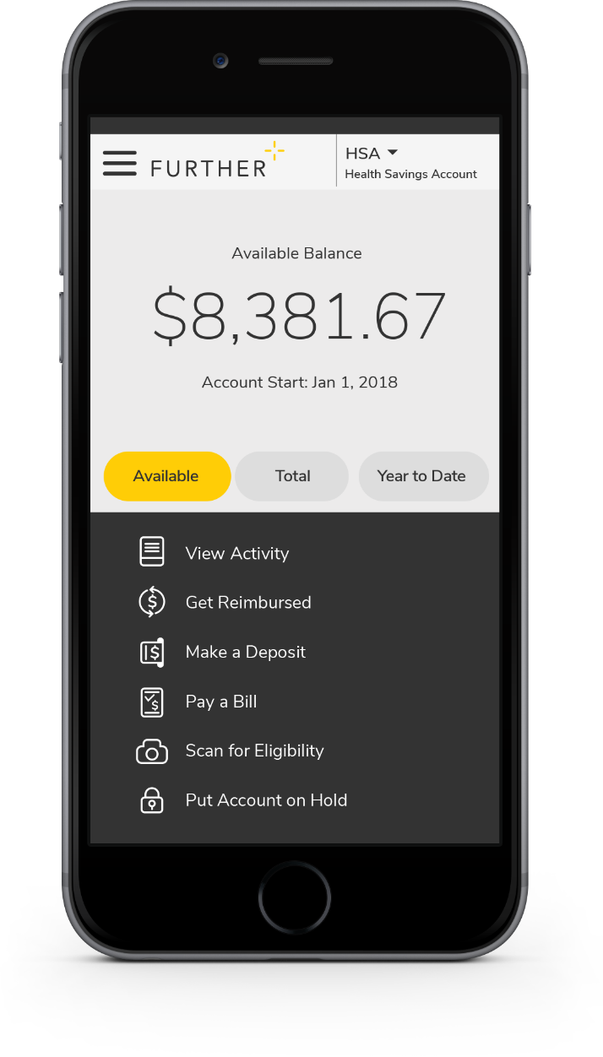
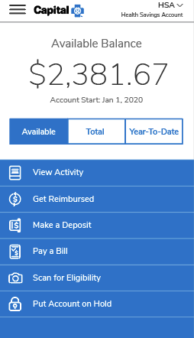
My Health Spending Assistant mobile app
Easy-to-use resource that features:
Fingerprint unlock.
Snap and save document photos.
Barcode scanner to check eligibility.
Mobile access to all primary actions.
View activity.
Pay bills.
Make deposits.
Get reimbursed.
Text options for account activities.

Slide 20
Let’s get started
Our expert service team is ready to help.
877.293.7041
Monday-Friday, 8:00 AM to 9:00 PM ET Saturday-Sunday, 9:00 AM to 5:00 PM ET
CapBlueCross.com/Funds
PSI-23 (06/22/23)

