Slide 1
Medical Flexible Spending Accounts
Spend every day wisely

Slide 2
Your Medical Flexible Spending Account (FSA)
Expense account that works with your health plan.
Pay qualified medical costs.
Set aside a portion of pretax payroll.
You could save 10% to 40% on these costs, depending on tax bracket¹.
2

Slide 3
How your FSA works – getting started
Estimate next year’s eligible medical costs, and elect to contribute up to that amount to an FSA.
Employer opens an FSA for you.
Equal portions deposited from your paycheck.
Total amount is available day one.
Contribute no more than what you think you will use, up to the applicable limit each year²:
Up to $3,200 for 2024.
3

Slide 4
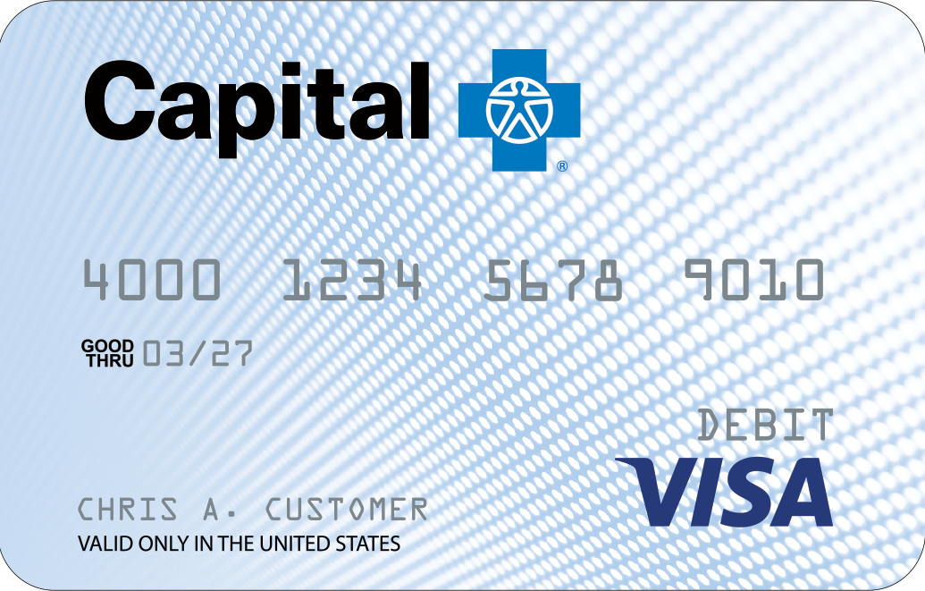
How your FSA works – paying medical expenses
Use our convenient Capital Blue Cross VISA debit card³ to pay providers.
OR
Receipts can be uploaded online to request payment directly to your healthcare providers.
4

Slide 5
Meet Susan
Single parent, one child
Annual salary | $58,000
FSA maximum contribution | $3,200
Taxable income | $54,800
Estimated tax rate⁴ | 25%
5

Slide 6
Susan’s savings
 | Without an FSA | With an FSA
Medical FSA contribution | $0 | $3,200
Estimated taxes⁴ | $14,500 | $13,700
Healthcare expenses | $3,200 | $3,200
Tax savings | $0 | $800
Net disposable income | $40,300 | $41,100
6

Slide 7
Qualified medical expenses
Expenses you can pay for:
Over-the-counter supplies, medications, and some feminine hygiene products.
Personal protective equipment such as masks, hand sanitizer, and sanitizing wipes.
Medical expenses that your health plan doesn’t cover:
Your deductible.
Copays and coinsurance.
Health expenses not included in your health plan:
Dental and vision care.
7

Slide 8
Qualified medical expenses
You can't use your FSA to pay for:
Costs not considered IRS-qualified expenses.
Visit the learning center at CapBlueCross.com/funds.
Health insurance premiums.
8

Slide 9
After you’re enrolled
Receive your debit card by mail.
Use your debit card to pay healthcare providers.
Visit CapBlueCross.com/funds often to:
View account activity.
Check balances.
Get forms.
Upload receipts.
Request additional debit cards.
9

Slide 10
Let’s get started
Our expert service team is ready to help.
877.293.7041
Monday-Friday, 8:00 AM-9:00 PM ET Saturday-Sunday, 9:00 AM-5:00 PM ET
CapBlueCross.com/funds
10
PSI-32 (12/05/23)

